Slide 1
Grants and Financial Management Training
May 22-24, 2024

Slide 2
CONTENTS
M11. RECIPIENT AND EMPLOYEE CONDUCT (OCTOBER 2023)
M12. DEBARMENT AND SUSPENSION (JUNE 2012)
M14. PREVENTING TRANSACTIONS WITH, OR THE PROVISION OF RESOURCES OR SUPPORT TO, SANCTIONED GROUPS AND INDIVIDUALS (MAY 2020)
M28. CONFLICT OF INTEREST (August 2018)

Slide 3
M11. RECIPIENT AND EMPLOYEE CONDUCT (OCTOBER 2023)
A personal conflict of interest is a situation which impair the employee’s ability to act impartially.
Must have written policies and procedures in place to prevent conflicts of interest.
Must disclose the COI and follow mitigating measures per policy.
Can’t accept gratuities, favors, or anything of monetary value from subrecipients or prospective subrecipients.

Slide 4
M12. DEBARMENT AND SUSPENSION (JUNE 2012)
Must not transact or conduct business with any individual or entity that has an active exclusion on the System for Award Management (SAM) (www.sam.gov).
The list contains those individuals and entities that has suspended or debarred based on misconduct or cannot be trusted.
Suspended or debarred entities or individuals are excluded from receiving any new work or any additional funding for the duration of the exclusion period.
May disallow costs, cancel the transaction, debar or suspend the recipient, or take other remedies as appropriate, if the recipient violates this provision.

Slide 5
M12. DEBARMENT AND SUSPENSION (JUNE 2012)
The recipient must notify immediately within duration of this award:
Are presently excluded or disqualified from doing business with USAID funds.
Have been convicted or found liable within the preceding three years for committing any offense indicating a lack of business integrity such as fraud, embezzlement, theft, forgery, bribery or lying;
Criminally charged by any governmental entity for any of the offenses or
Have had one or more USAID funded agreements terminated for cause or default within the preceding three years.

Slide 6
M14. PREVENTING TRANSACTIONS WITH, OR THE PROVISION OF RESOURCES OR SUPPORT TO, SANCTIONED GROUPS AND INDIVIDUALS (MAY 2020)
Recipient will not engage in transactions with, or provide resources or support to, any individual or entity that is subject to sanctions administered by OFAC or the United Nations (UN), including any individual or entity that is included on the Specially Designated Nationals and Blocked Persons List maintained by
  OFAC (https://www.treasury.gov/resource-center/sanctions/SDN-
  UN Security Council consolidated list (https://www.un.org/securitycouncil/content/un-sc-consolidated-list).
Any violation of the above will be grounds for unilateral termination of the agreement.

Slide 7
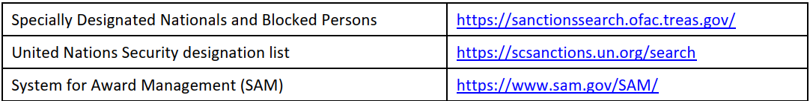
Debarment and Terrorism Searches
At a minimum, these searches should be performed through the public search engines outlined below:

Slide 8

M28. CONFLICT OF INTEREST (August 2018)
Conflict of interest is a situation in which a person has a private or personal interest sufficient to appear to influence the objective exercise of his or her official duties as an employee.
Required get COI policy signed by every staff and keep in the personal files

Slide 9
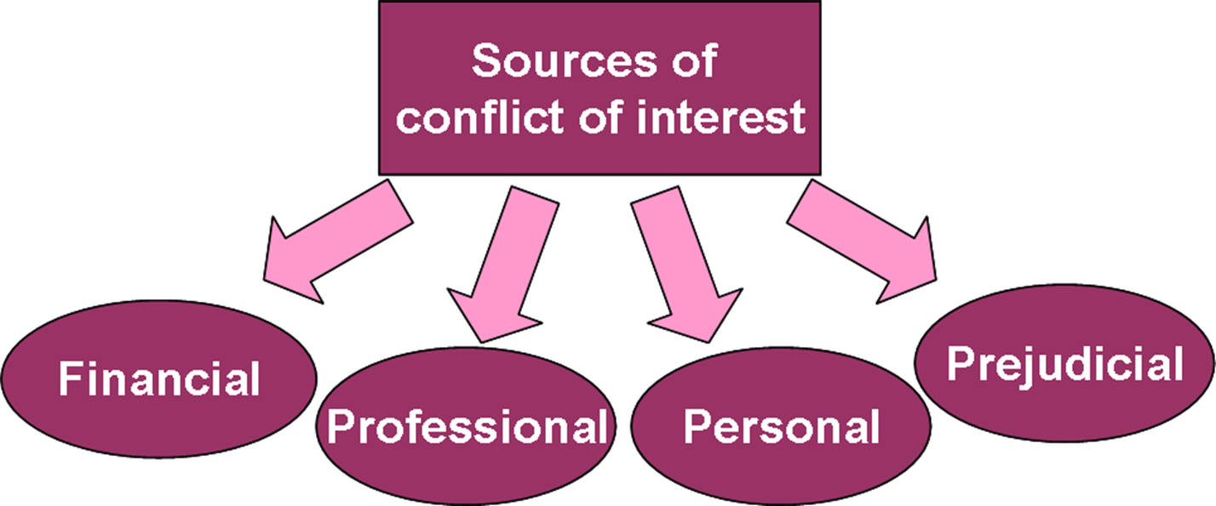
Sources

Slide 10
Examples of COI
Owning part of a business that sells goods or services to your organization while you are a member of the vendor selection committee
Sharing confidential information with a client or competitor
Accepting a favor or a gift from your vendors.
Engaging in employment or consultancy inconsistent with your organization’s interest.
Taking personal advantage of a business opportunity that your company might have pursued, itself

Slide 11
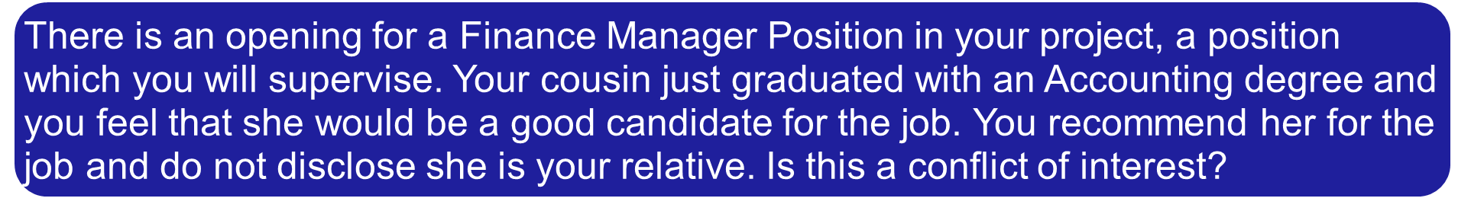
Quiz

Slide 12
Thank You!

