Slide 1

Internal Controls, Compliance, Risk Management and Internal Audit
By: Dr. Sarika Amatya, PhD
Finance and Administrative Director, FHI 360 Nepal

Slide 2
Internal control system
An internal control system is a process designed, implemented, and maintained by an organization's management and personnel. Its purpose is to provide reasonable assurance
Operational Efficiency and Effectiveness: Ensuring that operations are conducted in an efficient and effective manner.
Reliable Financial Reporting: Producing reliable financial reports and ensuring the accuracy and completeness of financial records.
Compliance with Laws and Regulations: Ensuring that the organization is in compliance with all applicable laws and regulations.

Slide 3
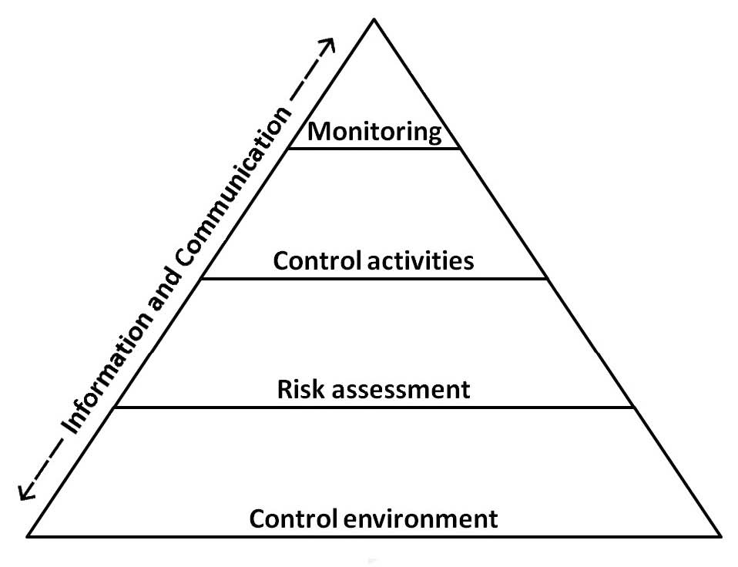
Framework of internal control -COSO model
The COSO model, developed by the Committee of Sponsoring Organizations of the Treadway Commission, is a framework for designing, implementing, and assessing internal control within an organization. The framework of internal control is a structured guide designed to help organizations manage and mitigate risks.

Slide 4
Components of Internal Control
1. Control Environment: The foundation for all other components of internal control, providing discipline and structure.
2. Risk Assessment: The organization's identification and analysis of relevant risks
3. Control Activities: The policies and procedures that help ensure management directives are carried out.
4. Information and Communication: Relevant information must be identified, captured, and communicated.
5. Monitoring: The process that assesses the quality of internal control performance over time.

Slide 5
Internal Audit
Internal auditing provides independent observation and services designed to add value and improve operations. Internal audits focus on the following areas and seek to improve compliance and strengthen controls.
Governance and general controls Financial reporting and budget monitoring Award management and data quality assurance Procurement and disbursements (including travel, consultants, and participant training) | Cash management Subaward management Property management HR and payroll IT controls Safety and security

Slide 6
Internal audit process
Internal audits follow a standard process. Each audit is unique, but each follows these four steps:
Planning
Fieldwork
Reporting
Follow-up

Slide 7
The Office of Compliance and Internal Audit (OCIA)
The following key functions are managed by Office of Compliance and Internal Audit (OCIA):
Internal Audit
Investigations / Sexual Exploitation and Abuse (SEA)
Compliance
Risk Management

Slide 8
Compliance
Its commitment to comply with the laws, regulations and contractual obligations to which we are subject. Its purpose is to ensure that we are good and responsible stewards of donor funds.
A Culture of Compliance:
Compliance is not only about following all applicable laws and regulations; committed to maintaining a work environment where integrity and ethical practices are an everyday part of how we conduct our work. Because compliance starts with all of us.

Slide 9
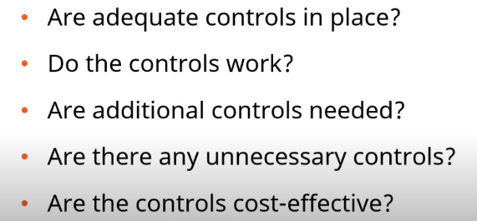
Reflections
Answering these three questions helps us maintain our culture of compliance:
Why is something being requested (the underlying purpose)?
What is the basis for that request (the law)?
How do I properly comply (the procedure)?

Slide 10
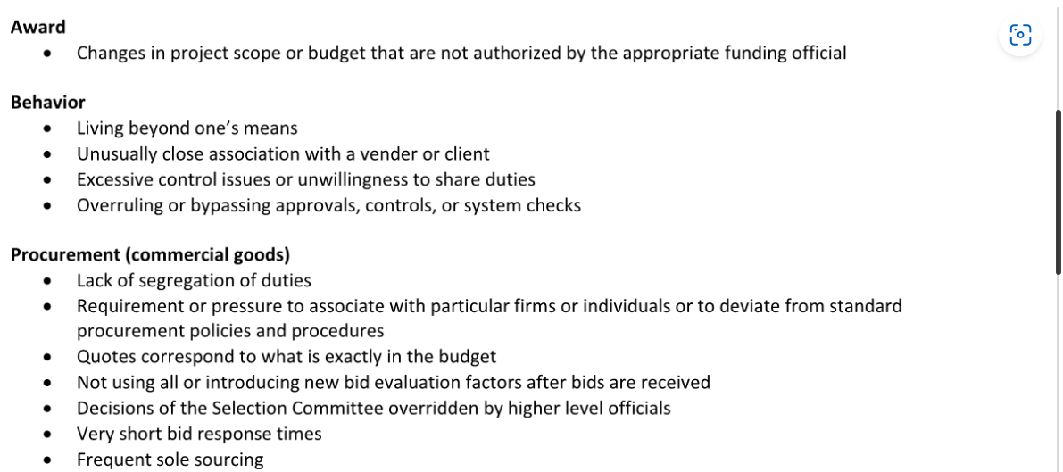
Red Flags Red Flags of Non-Compliance

Slide 11
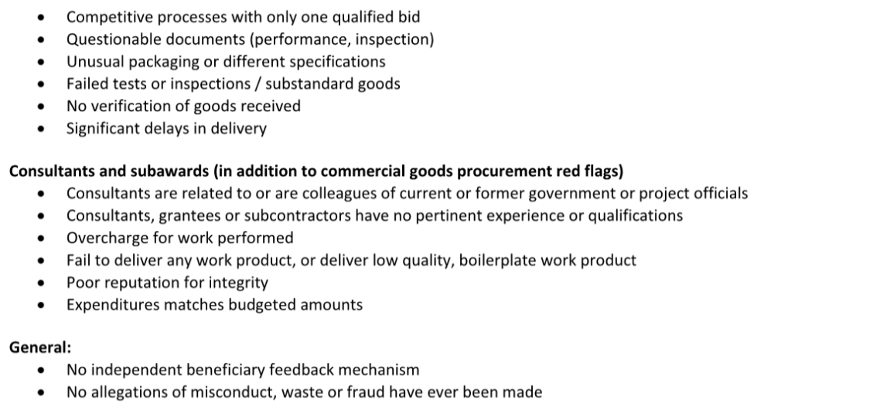
Red Flags Red Flags of Non-Compliance

Slide 12
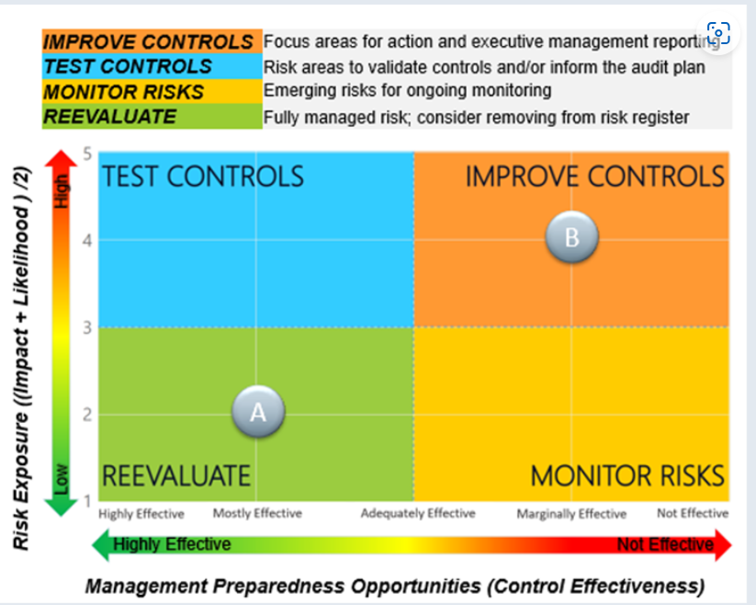
Risk Management
Manage risk through Action Matrix; determine the type of action to take for each risk area.
  Improve Controls - Focus areas for action and executive management reporting. This represents high risk exposure with ineffective internal controls.
  Test Controls - Risk areas in validate controls. This represents high risk exposure with effective internal controls.
  Monitor Risks - Emerging risks for ongoing monitoring. This represents low risk exposure with ineffective internal controls.
  Reevaluate - Fully managed risk. This represents low risk exposure with effective internal controls.

Slide 13
Managing Risk Through Action Matrix
To effectively manage risk, it is essential to utilize an Action Matrix. This tool allows us to categorize risks and determine the most appropriate course of action for each identified risk area.
The process involves the following steps:
Identify Risks: List all potential risks that could impact the project.
Assess Risks: Evaluate the likelihood and impact of each risk.
Categorize Risks: Use the Action Matrix to categorize risks based on their assessment.
Determine Actions:
• Avoid: Implement measures to prevent the risk from occurring.
• Transfer: Shift the risk to a third party, such as through insurance.
• Mitigate: Reduce the likelihood or impact of the risk.
• Accept: Acknowledge the risk and decide to deal with it if it occurs.
For each risk area, consider the following:
• Probability: How likely is the risk to occur?
• Impact: What would be the consequences if the risk materializes?
• Response: What actions can be taken to manage the risk?

Slide 14
Risk mitigation activity tracking method
What activities are we tracking?
Risk mitigation activities are the planned controls and activities that will mitigate the risks but that are not yet in place.
  For example, the development of a process that has not yet been implemented or an upcoming activity that is planned to occur in the future.
How do we determine what to include in activity tracking?
The mitigation activities that FHI 360 tracks are determined from the mitigation plans for each risk area.
  Mitigation plans can include the current controls already in place as well as descriptions of potential controls to develop in the future.

Slide 15
Thank You!
FHI 360 Nepal Office
Gopal Bhawan, Baluwatar, Kathmandu-4, Nepal
www.fhi360.org/countries/nepal
FHI 360 Headquarters
359 Blackwell Street, Suite 200, Durham, NC 27701 USA
www.fhi360.org

